Slide 1

The Machine Learning Process
How do I remove columns from a pandas DataFrame?
Dr. Reza Dibaj

Slide 2

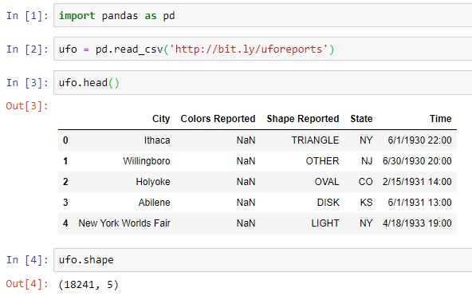
How to remove columns from pandas
pandas DataFrame is the primary unit of data storage in the pandas library that contains rows and columns.
How could we remove columns from our DataFrame?
Let’s pull up an example dataset as follows:
Notes:
import pandas as pd
ufo = pd.read_csv('http://bit.ly/uforeports’)
ufo.head()
ufo.shape

Slide 3
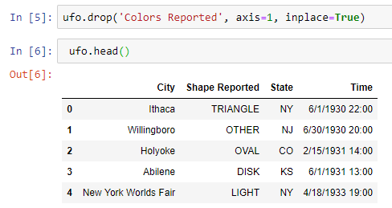
Removing one column
Imagine that we do not want ‘Colors Reported’ column. For this we need to use a drop method, as follows:
axis = 1 → column
axis = 0 → row (default)
When we want the operation to occur in place
There is no ‘Colors Reported’ column anymore.
Notes:
ufo.drop('Colors Reported', axis=1, inplace=True)
ufo.head()

Slide 4
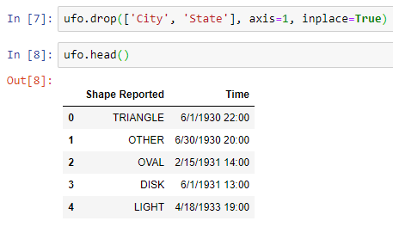
Removing number of columns
What if we want to remove ‘City’ and ‘State’ columns at the same time. In this case we pass a list of strings as follows:
List of columns
No ‘City’ and ‘State’ columns.
Notes:
ufo.drop(['City', 'State'], axis=1, inplace=True)
ufo.head()

Slide 5

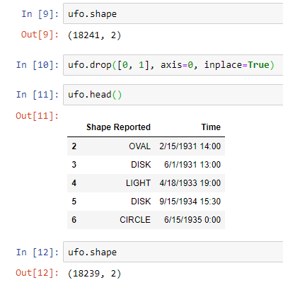
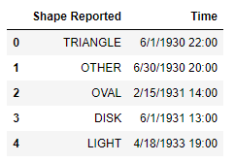
Bonus Tip
What if we want to delete one or a few rows?
axis = 1 → column
axis = 0 → row (Default)
Notes:
ufo.shape
ufo.drop([0, 1], axis=0, inplace=True)
ufo.head()
ufo.shape

Slide 6

Thank you
Question?
To be
Not to be

